Slide 1
Design & Implement Community Portal Database
Module Project
Module: Database Design and Implementation
Course: NICF-Advanced Certificate in Infocomm Technology (Software & Applications)
Start Date : January 6, 2023
End Date : January 31, 2023
Submission Date : January 31, 2023
Learner Name : Francis Roel L. Abarca
Enrollment ID : BDSE-0922-113
Presentation Date :

Slide 2
Contents
Document History
Version Number | Effective Date of release | Summary of Included Changes | Author
1 | 4th March 2016 | First Edition | Satya CVS
4 | 26th July 2017 | Changed for Module 4 | Shrinivas K R
5 | 5th June 2018 | Changed for Module 4 RQF | Shrinivas K R

Slide 3
Contents
Contents
S. No. | Description
01 | Development Tools
02 | Database Requirements
03 | Entities
04 | Conceptual Design
05 | Logical Design
06 | Tables
07 | Fields
08 | Primary Key, Foreign Key & Indexes
09 | SQL Queries
10 | Report Queries
11 | Indexes
12 | Backup Script
13 | Project Milestones & Tasks

Slide 4
Contents
Contents
S. No. | Description
17 | Milestone Feedback & Action taken
18 | Modifications Made based On Feedback
19 | Project Results
20 | Proposed Improvements

Slide 5

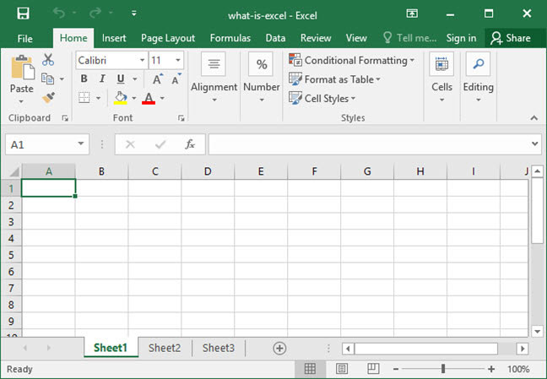

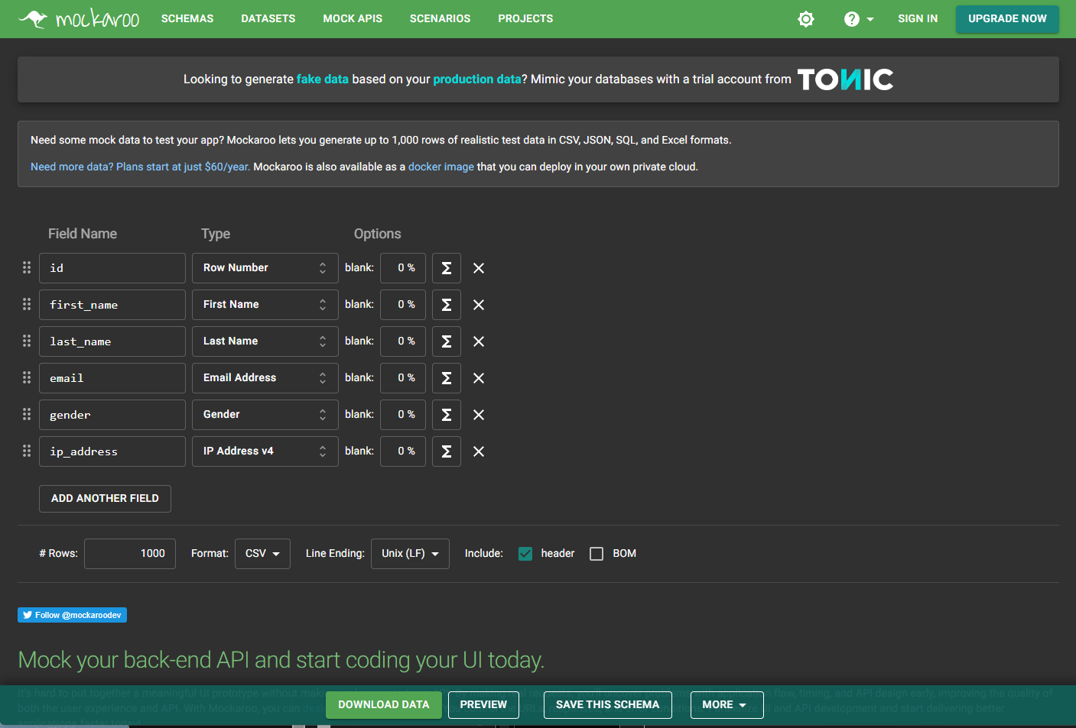
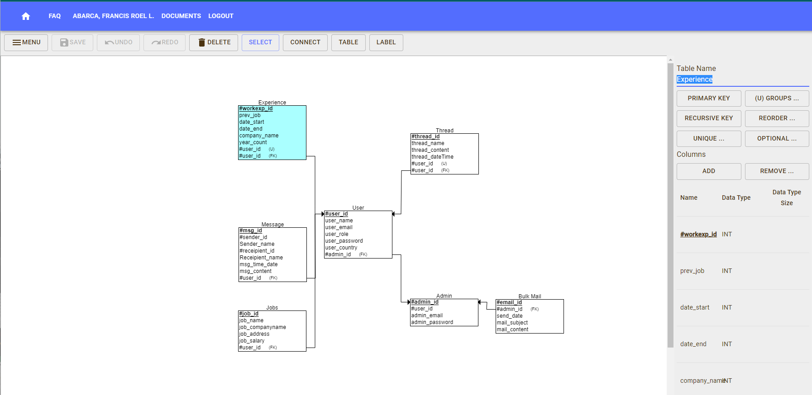

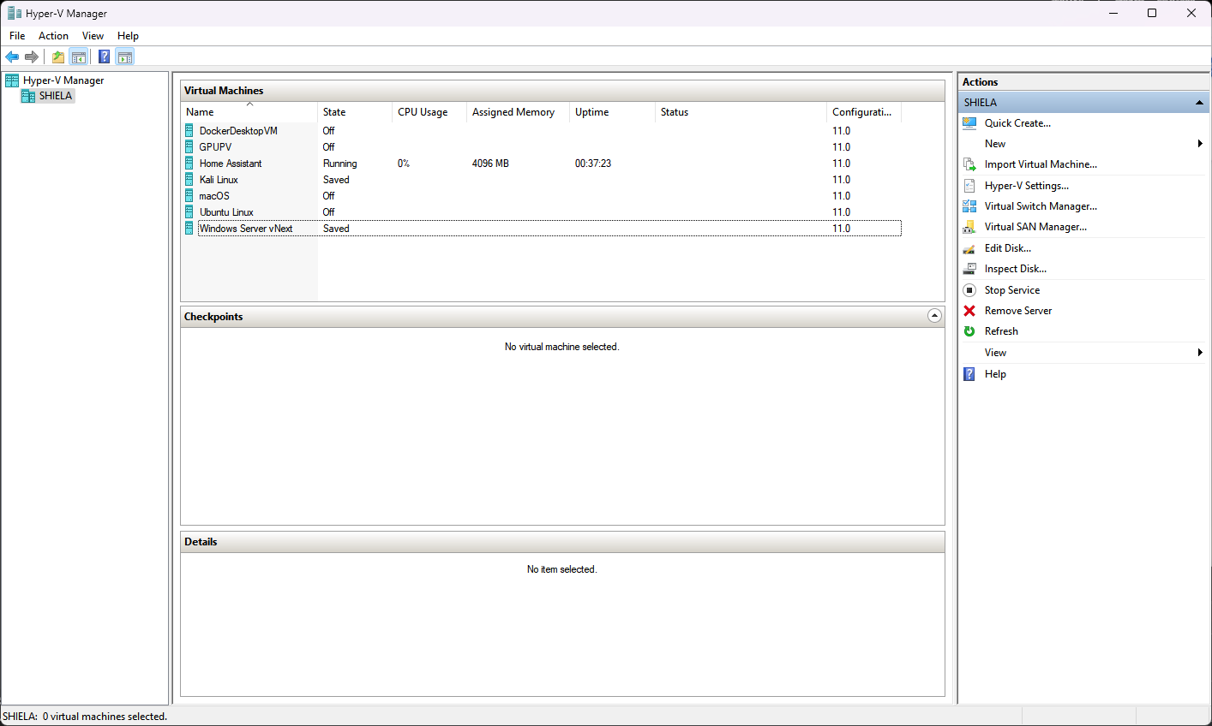
1. Development Tools
Development Tools Screen captures
  Mockaroo – Generate Sample Data
  Hyper-V – To run the database server
  Microsoft Excel – Normalize the Data
  ERDPlus – Create the Relational and ER Diagram

Slide 6

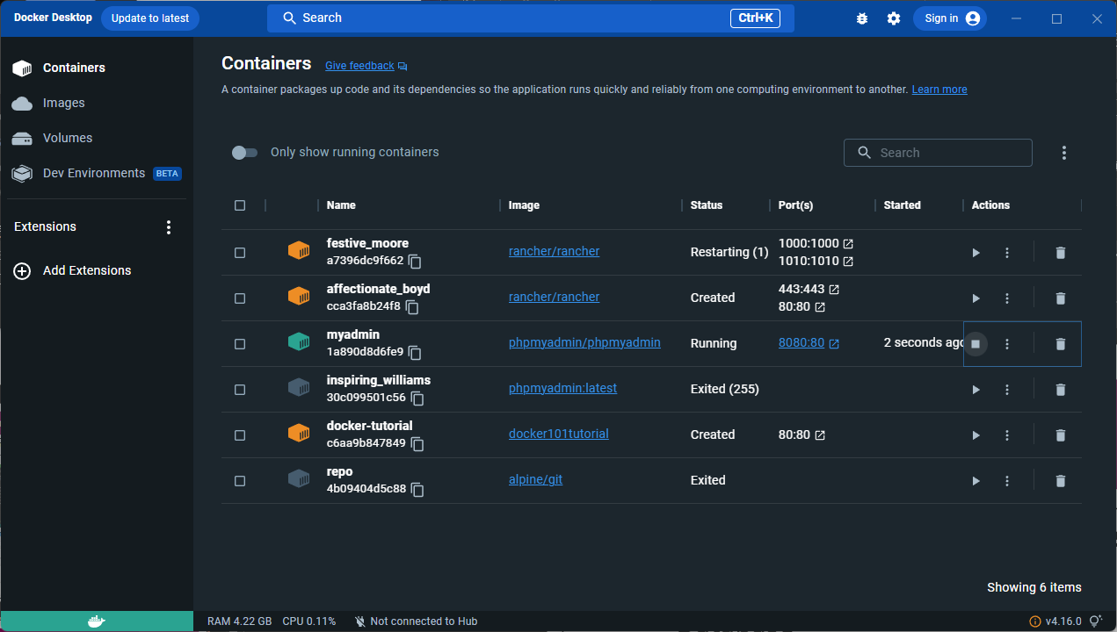
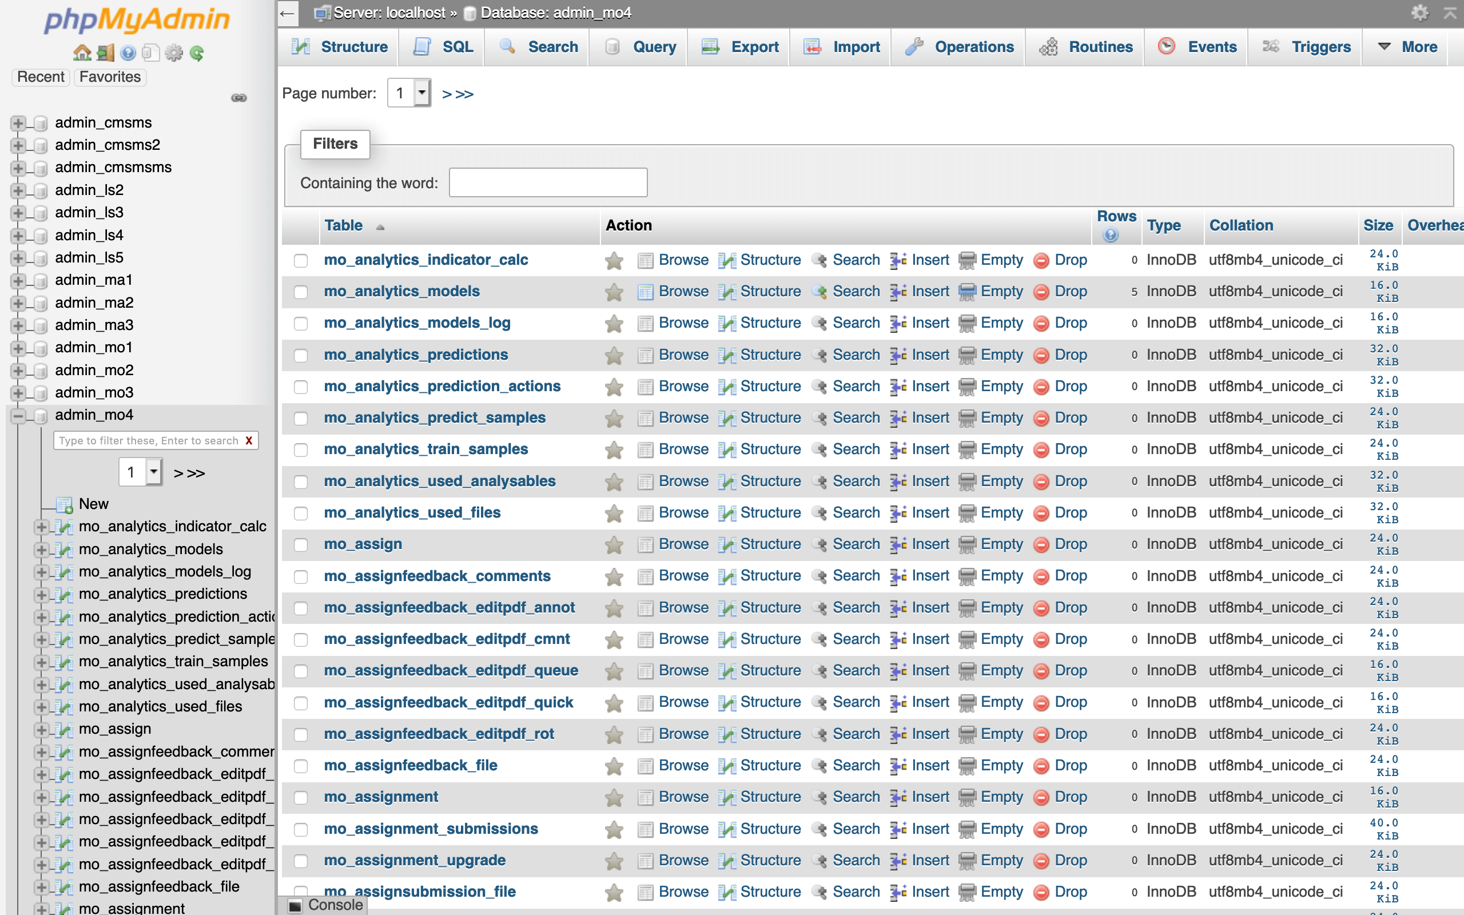
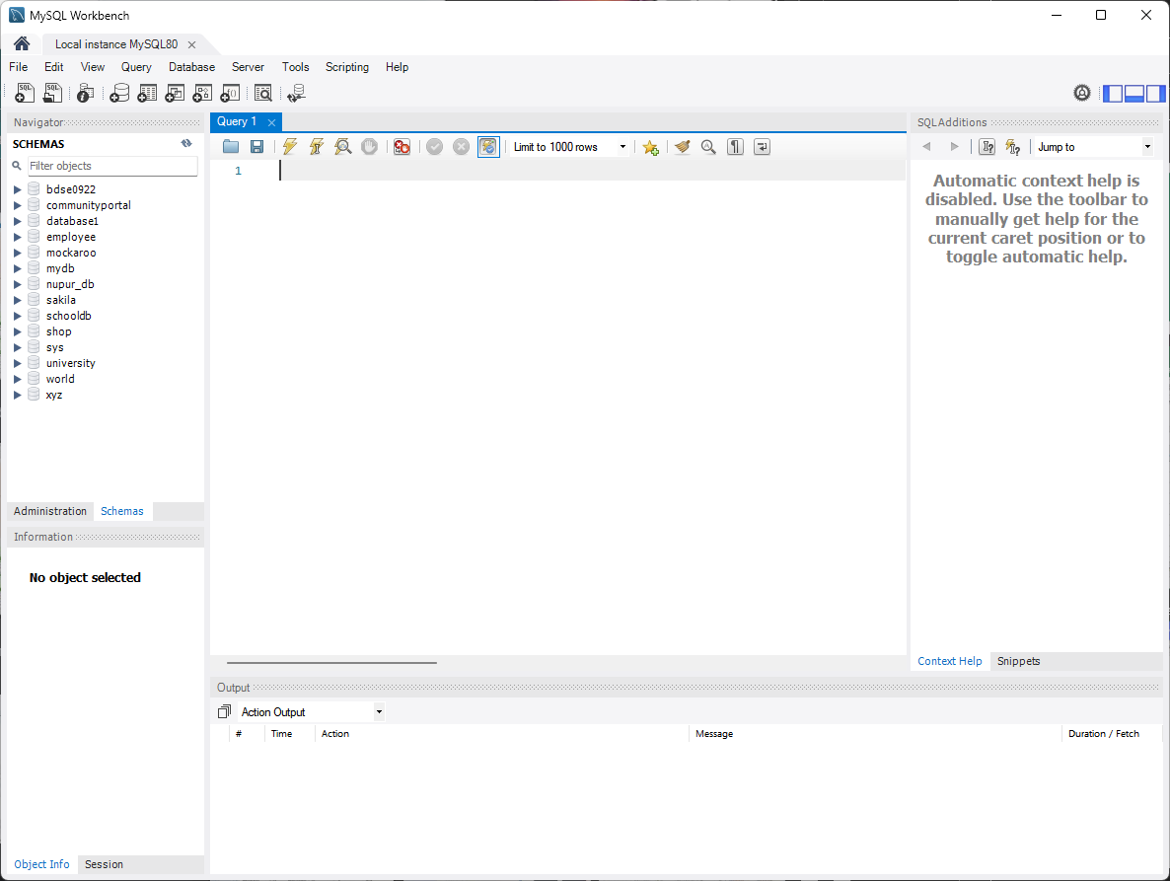
1. Development Tools
Development Tools Screen captures
  MySQL Server 8.0 – Host the Database
  MySQL Workbench – To perform CRUD operations to the DB
  Docker + phpMyAdmin – Host the phpMyAdmin container for Data Dictionary

Slide 7
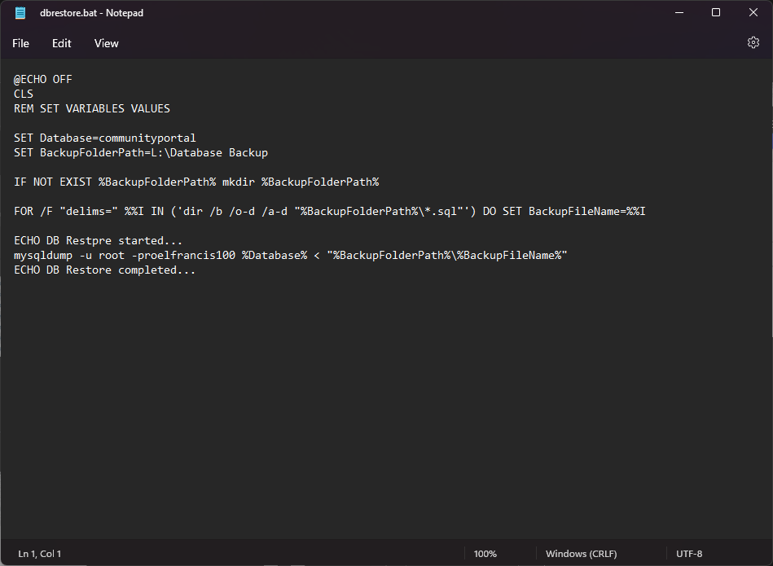
1. Development Tools
Development Tools Screen captures
  Microsoft Notepad – Write the Backup and Restore Batch Files

Slide 8
2. Database Requirements
Hardware Requirements
  Multi-Core CPU (6 cores is preferred)
  16GB of RAM or higher
  250GB SSD or higher
  500GB HDD or higher

Slide 9
2. Database Requirements
Software Requirements
  Windows 10 Pro or Windows 11 Pro or Windows Server 2022
  Microsoft Hyper-V
  MySQL Server (Database Server)
  MySQL Workbench (Database Client)
  Docker
  phpMyAdmin
  Google Chrome
  Command Prompt + SSH
  Task Scheduler
  Notepad

Slide 10
2. Database Requirements
Design Requirement
Entity | Description | Page/Function
Users | Contains information relevant to the user during log-in sessions and profile viewing. | Log-in, Registration
Jobs | Contains information about the Jobs available currently. | Search, Profile Page
Work Experience | Contains information about the user’s experience on specific jobs. | Profile Page
Admin | Contains the list of people who have administrative privileges to the website. | Profile Page, Mail Manager
Message | Contains the messages and conversations they have with the users and companies in the Community Portal. | Messages
Thread | Provides users a space to discuss and talk about work related stuff inside the Community Portal. | Thread Page
Bulk Mail | Contains the list of bulk emails that are sent to users | Mail Manager

Slide 11
3. Entities
No | Emtity One | Entity Two | Relationship | Note/Description
1 | User | Admin | Many to One | Many users can be an admin
2 | User | Jobs | One to Many | One user can apply multiple jobs.
3 | User | Work Experience | One to Many | One user can have many work experiences.
4 | User | Message | One to Many | One User can send and receive messages.
5 | User | Threads | One to Many | One user can create and interact with many threads.
6 | Admin | Bulk Email | Many to Many | Many admins can create multiple bulk mails.

Slide 12
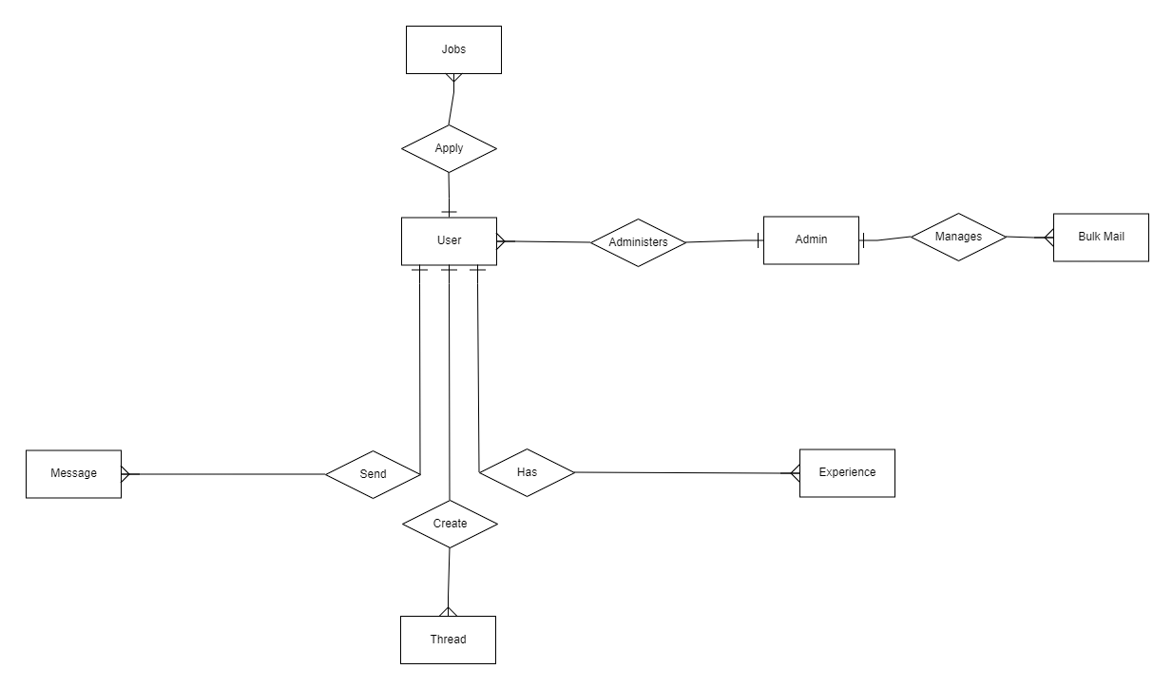
4. Conceptual Design

Slide 13
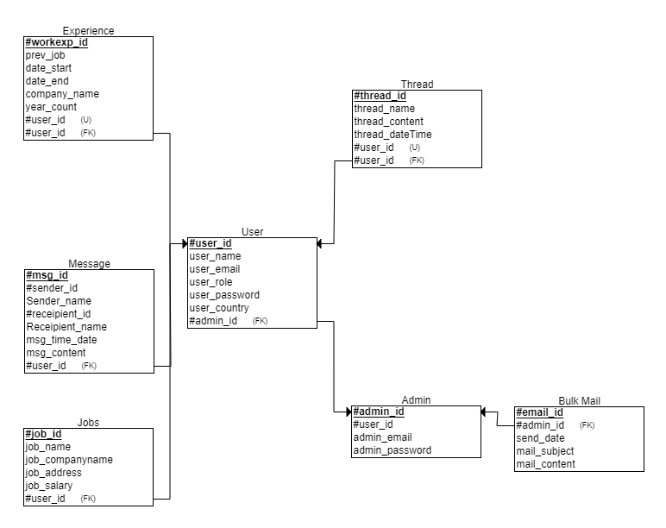
5. Logical Design

Slide 14
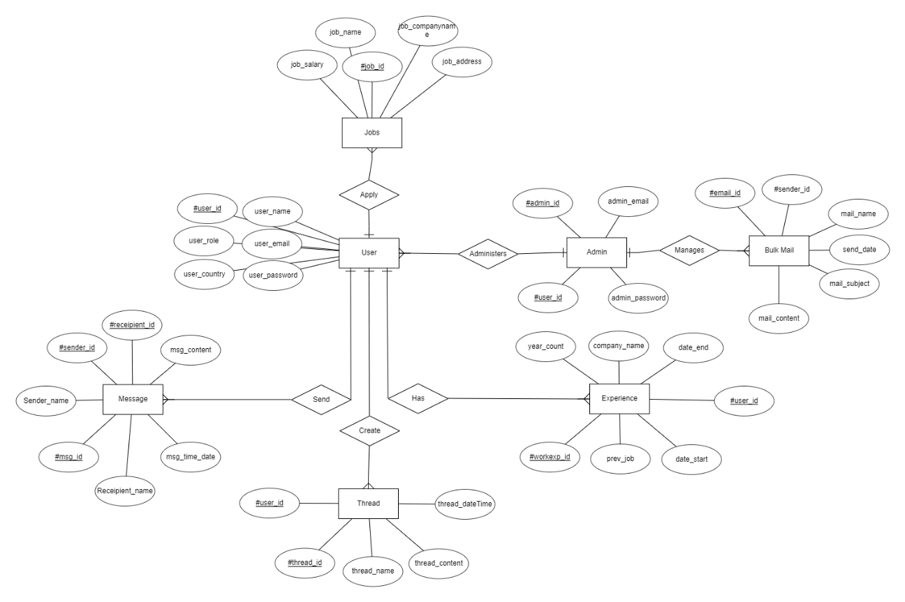
ER Diagram

Slide 15
6. Tables
Tables
S. No. | Tables | Purpose of Table
1 | Users | Contains information relevant to the user during log-in sessions and profile viewing.
2 | Jobs | Contains information about the Jobs available currently.
3 | Work Experience | Contains information about the user’s experience on specific jobs.
4 | Admin | Contains the list of people who have administrative privileges to the website.
5 | Message | Contains the messages and conversations they have with the users and companies in the Community Portal.
6 | Thread | Provides users a space to discuss and talk about work related stuff inside the Community Portal.
7 | Bulk Mail | Contains the list of bulk emails that are sent to users.

Slide 16
7. Fields
Users Table
Column | Type | Null | Default | Comments
#user_id (Primary) | Int | No
User_name | Varchar(50) | No
User_email | Varchar(50) | Yes | NULL
User_role | Varchar(20) | No
User_password | Varchar(15) | No
User_country | Varchar(20) | No
#admin_id | Int | Yes | NULL

Slide 17
7. Fields
Jobs Table
Column | Type | Null | Default | Comments
#job_id (Primary) | Int | No
#user_id | Int | No
job_name | Varchar(50) | No
Job_companyname | Varchar(50) | No
Job_address | Varchar(50) | No
Job_salary | double | No

Slide 18
7. Fields
Work Experience Table
Column | Type | Null | Default | Comments
#workexp_id (Primary) | Int | No
Prev_job | Varchar(50) | No
Company_name | Varchar(50) | No
Date_start | Varchar(25) | No
Date_end | Varchar(25) | No
Year_count | int | No
#user_id | Int | No

Slide 19
7. Fields
Admin Table
Message Table
Column | Type | Null | Default | Comments
#admin_id (Primary) | Int | No
#user_id | Int | No
Admin_password | Varchar(15) | No
Admin_email | Varchar(50) | Yes | NULL
Column | Type | Null | Default | Comments
#msg_id (Primary) | Int | No
#sender_id | Int | No
#receipient_id | Int | No
Msg_time_date | datetime | No
Msg_content | Varchar(500) | No

Slide 20
7. Fields
Thread Table
Bulk Mail Table
Column | Type | Null | Default | Comments
#thread_id (Primary) | Int | No
#user_id | Int | No
Thread_name | Varchar(50) | No
Thread_content | Varchar(200) | No
Thread_dateTime | datetime | No
Column | Type | Null | Default | Comments
#email_id (Primary) | Int | No
#admin_id | Int | No
Send_date | Varchar(25) | No
Mail_subject | Varchar(25) | No
Mail_content | Varchar(200) | No

Slide 21
8. Primary Key, Foreign Key & Indexes
Primary Key
No | Key Column | Table
1 | #user_ID | User
2 | #admin_ID | Admin
3 | #job_id | Jobs
4 | #msg_id | Message
5 | #thread_id | Thread
6 | #email_id | Bulk Mail
7 | #workexp_id | Experience

Slide 22
8. Primary Key, Foreign Key & Indexes
Foreign Key
No | Key Column | Table | Constraint Name | Reference Column | Reference Table
1 | #user_ID | User | #user_id_ibfk_1 | #user_id | User
2 | #admin_ID | Admin | #admin_id_ibfk_1 | #user_id | User
3 | #sender_id | Message | #sender_id_ibfk_1 | #user_id | User
4 | #recipient_id | Message | #receipient_id_ibfk_1 | #user_id | User

Slide 23
8. Primary Key, Foreign Key & Indexes
Indexes
No | Name | Type | Column | Table
1 | PRIMARY | BTREE | #admin_id | Admin
2 | PRIMARY | BTREE | #user_id | User
3 | PRIMARY | BTREE | #workexp_id | Experience
4 | PRIMARY | BTREE | #thread_id | Thread
5 | PRIMARY | BTREE | #msg_id | Message
6 | PRIMARY | BTREE | #job_id | Job
7 | PRIMARY | BTREE | #mail_id | Bulk Mail

Slide 24
9. SQL Queries
Page | Tables | Function | Query
Log-in | User | Validate Credentials | SELECT user_email, user_password FROM `user` WHERE user_email = 'adamtheman@abc.org' AND user_password = 'adamman1927';
2. Registration | User | Add Credentials | INSERT INTO user (user_name, user_email, user_password, user_country) VALUES (“Allan Kay”, allankay69@gmail.com, “ieu4-81ka-1a6d”);
3. View Profile | User | View Credentials | SELECT user_name, user_email, user_password FROM user WHERE Email = “registered email” AND user_name= “registered name”;

Slide 25
9. SQL Queries
Page | Tables | Function | Query
4. List Search Results | Jobs | View Jobs available | SELECT * FROM communityportal.jobs WHERE (job_name LIKE '%Software%' OR 'Software' = '') AND (job_address LIKE '%california%' OR 'california' = '') AND (job_salary >= 100000 OR 100000 = 0);
5. Messages | Messages | Read and Send Messages | INSERT INTO messages (sender_id, recipient_id, msg_content) VALUES ({sender_id}), {receiver_id}, ‘{msg_content}’, ‘{sent_at}’);
6. Threads | Thread | Create Threads | INSERT INTO thread (`#user_id`, thread_name, thread_content) VALUES (3, 'Service', 'ServiceTesting');
7. Job Opportunities | Job Experience, Jobs | Show and recommend jobs based on experience. | SELECT j.* FROM job j JOIN experience e ON j.id = e.job_id WHERE e.user_id = {user_id} GROUP BY j.id HAVING COUNT(e.job_id) >= {year_count};
8. Admin | Admin | Manage the Community Portal | SELECT * FROM admin WHERE admin_email = {admin_email} AND admin_password = ‘{admin_password}’;

Slide 26
9. SQL Queries
No | Note | Query | Evidence
1 | Table Existence Test: Add data to the ‘user’ table to verify if exists or not. | SELECT * FROM communityportal.user; | Logs show ’10 row(s) returned’
2 | Data Insertion Test: Check if the table is able to receive and enter 1 data entry. | INSERT INTO communityportal.user (user_name, user_email, user_role, user_password, user_country) VALUES ("Adam Phil", "adamphil21@gmail.com", "member", "ads82-ad9a-9saw", "United States"); | Logs show “1 row(s) affected”
3 | Primary Key Test: Insert a duplicate value for the #thread_id column for thread. | INSERT INTO communityportal.thread (`#thread_id`, `#user_id`, thread_name, thread_content, thread_dateTime) VALUES (1, 5, "Testing", "Testing123", "2023-01-21 11:59:57"); | Logs show a report of an error indicating a Duplicate entry for thread ‘PRIMARY’.
4 | Data Type Test: Insert a email that has more than 50 characters on the user_email column. | INSERT INTO communityportal.user (user_email) VALUES ("qwertyreeeeeeeeeeeeeeeeeeeeeeeeeeeeeeeeeeeeeeeeeeeeeeeeeeeeee@gmail.com"); | Log show a report of an error indicating tha the “Data too long for column ‘user_email’.
5 | Column Existence Test: Check if the column `msg_content` is available. | SELECT msg_content FROM communityportal.message; | Logs show “10 row(s) returned”

Slide 27
10. Report Queries
S. No. | Purpose of Query | Query
1 | Read and Send Messages | INSERT INTO messages (sender_id, recipient_id, msg_content) VALUES ({sender_id}), {receiver_id}, ‘{msg_content}’, ‘{sent_at}’);
2 | View Jobs available | SELECT * FROM communityportal.jobs WHERE (job_name LIKE '%Software%' OR 'Software' = '') AND (job_address LIKE '%california%' OR 'california' = '') AND (job_salary >= 100000 OR 100000 = 0);
3 | Create Threads | INSERT INTO thread (`#user_id`, thread_name, thread_content) VALUES (3, 'Service', 'ServiceTesting');
4 | Show and recommend jobs based on experience. | SELECT j.* FROM job j JOIN experience e ON j.id = e.job_id WHERE e.user_id = {user_id} GROUP BY j.id HAVING COUNT(e.job_id) >= {year_count};
5 | Manage the Community Portal | SELECT * FROM admin WHERE admin_email = {admin_email} AND admin_password = ‘{admin_password}’;

Slide 28
10. Report Queries
S. No. | Purpose of Query | Query
6 | Validate Credentials | SELECT user_email, user_password FROM `user` WHERE user_email = 'adamtheman@abc.org' AND user_password = 'adamman1927';
7 | Add Credentials | INSERT INTO user (user_name, user_email, user_password, user_country) VALUES (“Allan Kay”, allankay69@gmail.com, “ieu4-81ka-1a6d”);
8 | View Credentials | SELECT user_name, user_email, user_password FROM user WHERE Email = “registered email” AND user_name= “registered name”;

Slide 29
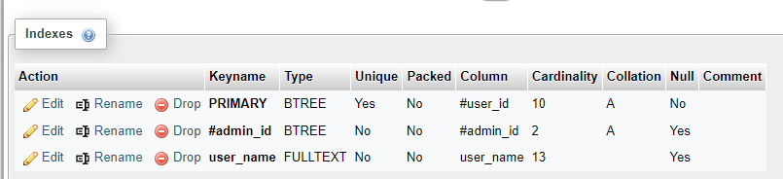
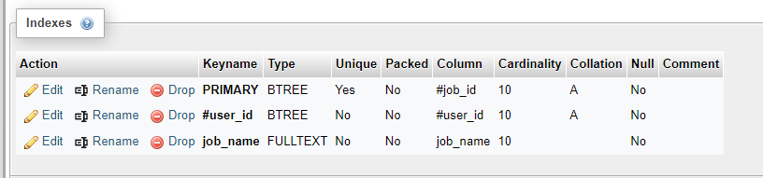
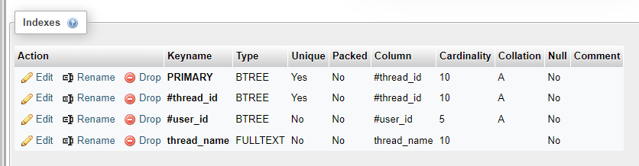
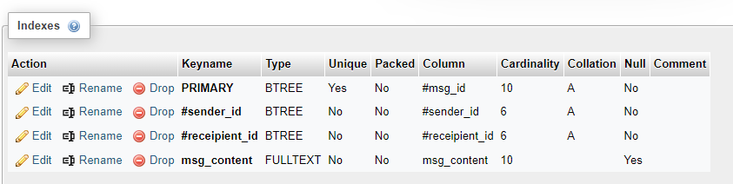
11. Indexes
Index Message
  CREATE FULLTEXT INDEX user_name ON user (user_name)
  CREATE FULLTEXT INDEX job_name ON jobs (job_name)
  CREATE FULLTEXT INDEX thread_name ON thread (thread_name)
  CREATE FULLTEXT message_content ON message (msg_content)

Slide 30
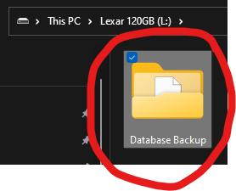
12. Backup Script
Script Batch File
  Create the folder where you want to back-up the database

Slide 31
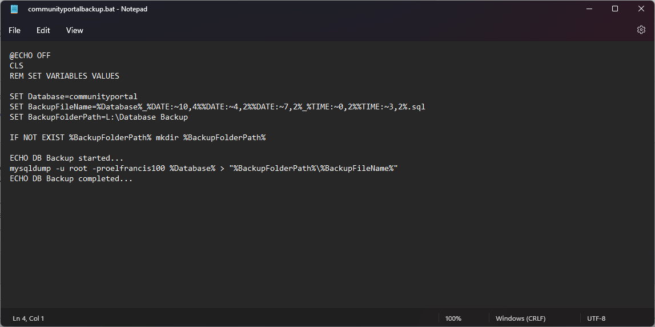
12. Backup Script
Script Batch File
  Create a script that consists of the name of your database and where you want to export the backup itself.

Slide 32
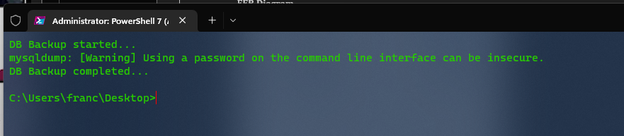
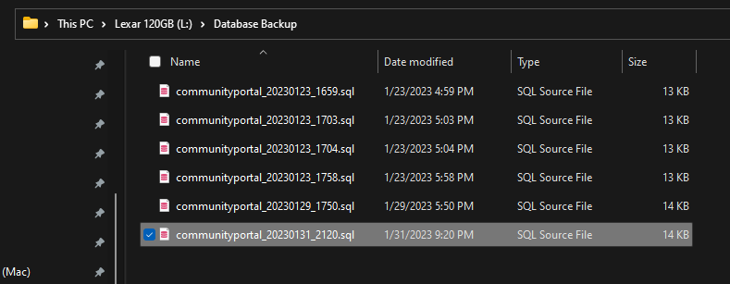
12. Backup Script
Script Batch File
  Test the Batch File

Slide 33
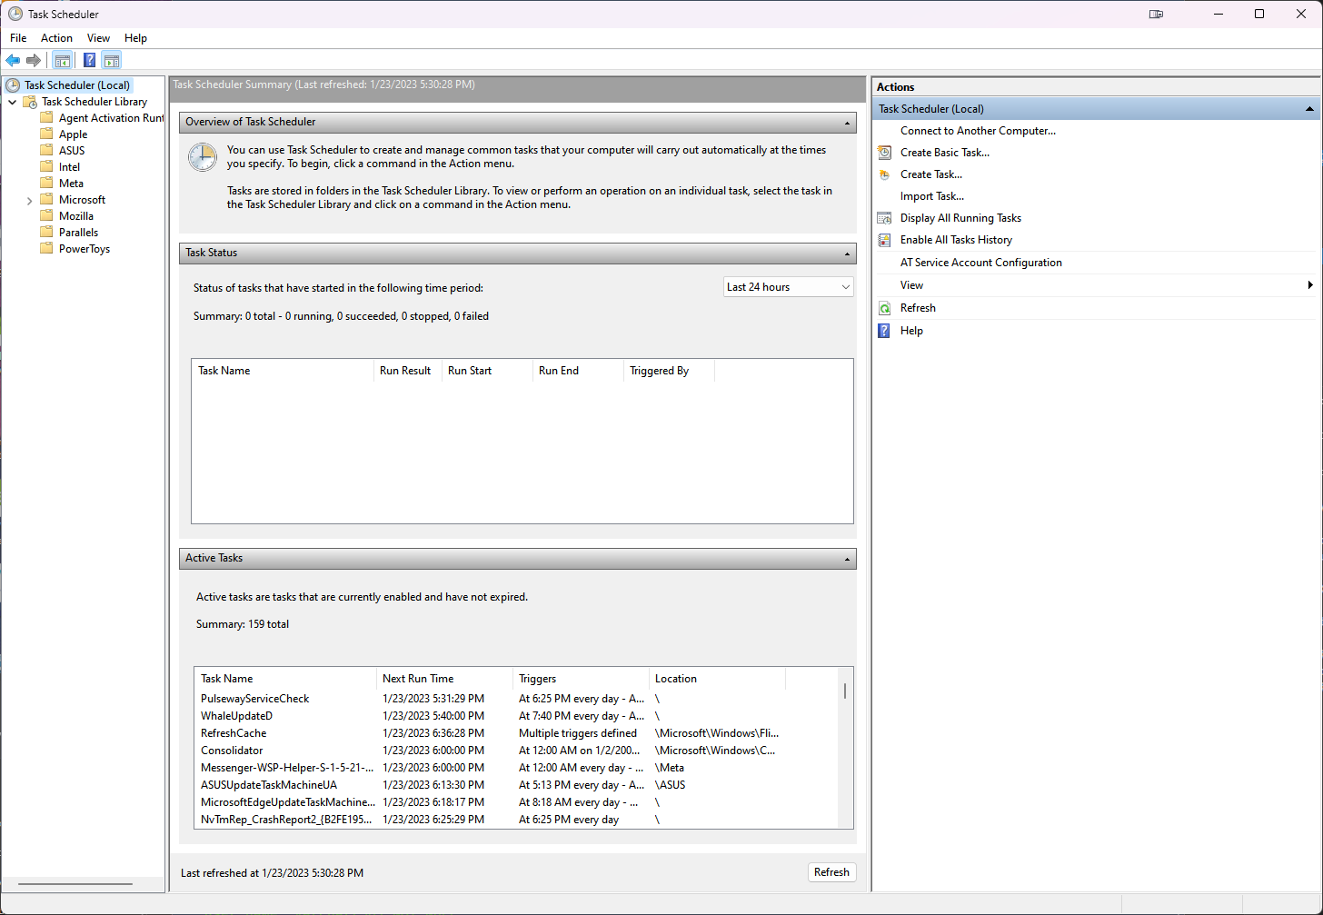
12. Backup Script
Script Batch File
  After that, Open Task Scheduler

Slide 34
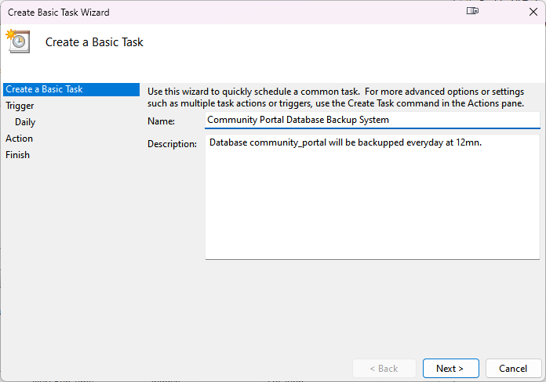
12. Backup Script
Script Batch File
  Click on Create a Basic Task

Slide 35
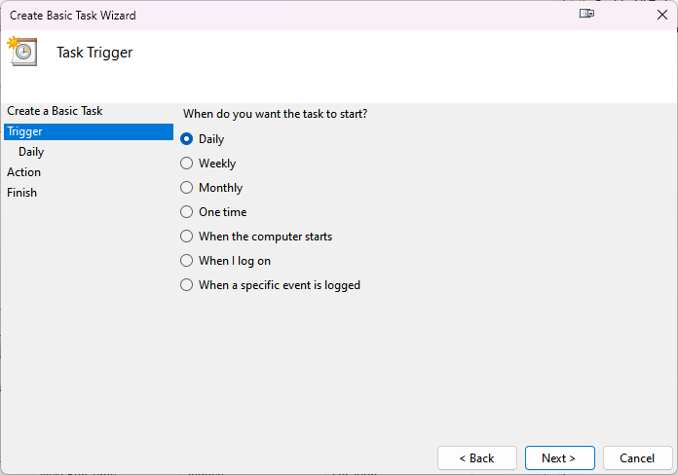
12. Backup Script
Script Batch File
  Set start trigger for the task

Slide 36
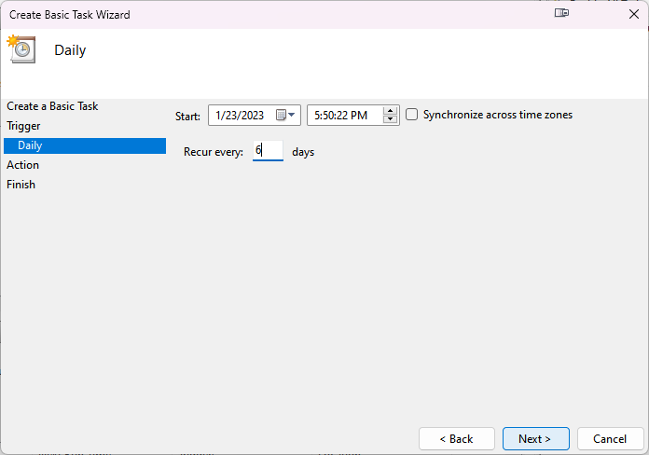
12. Backup Script
Script Batch File
  Set the start date of the task and its interval.

Slide 37
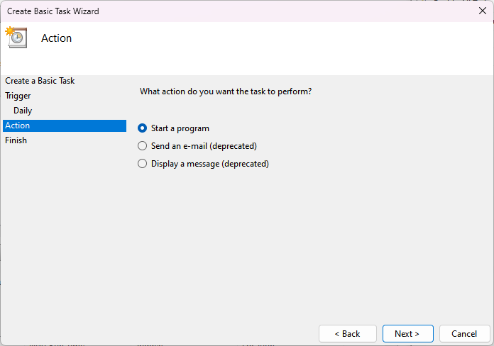
12. Backup Script
Script Batch File
  Set the task to start a program

Slide 38
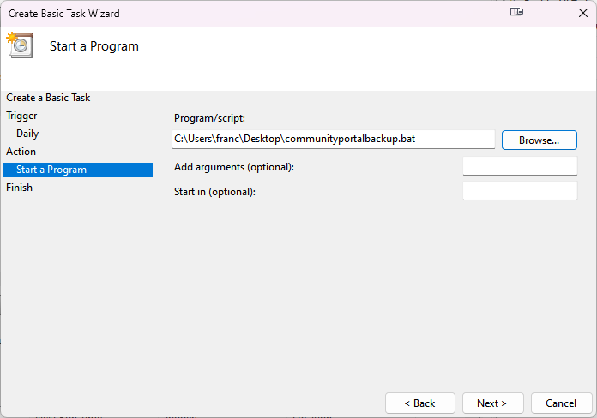
12. Backup Script
Script Batch File
  Select your backup script

Slide 39
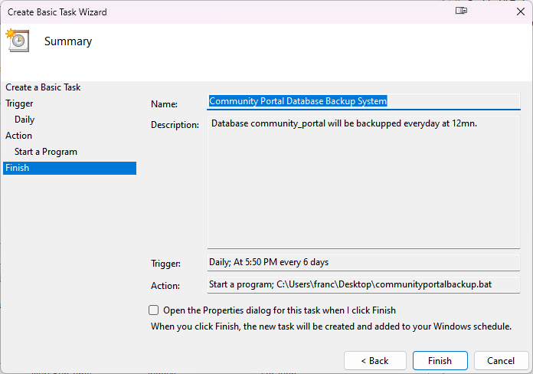
12. Backup Script
Script Batch File
  Review your configuration then click Finish.

Slide 40
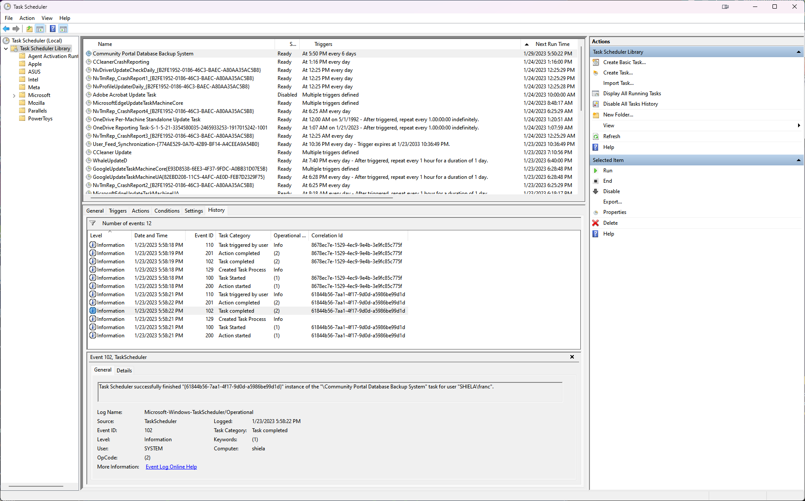
12. Backup Script
Script Batch File
  Run and monitor the task inside Task Scheduler.

Slide 41
13. Project Milestones & Tasks
Project Task ID | Project Major Task Description | Project Milestone ID
1 | Setup the Development Environment based on the Technical Development Environment | 1
2 | Power point detailing the entities, tables and fields which need to created | 1
3 | Power point will also include Conceptual, Logical Design | 1
4 | Develop the Schema creation script or Implement using phpMyAdmin | 2
5 | Power point which Analyze and list the Queries which need to be created based on project requirements | 3
6 | Testing, Indexes & Backup Script | 3

Slide 42
14. Milestone Feedback & Action taken
Project Milestone ID | Milestone Feedback received from Tutor / Learning Facilitator | Action Taken (Yes / No)
1
2
3

Slide 43
15. Modifications Made based On Feedback

Slide 44
16. Project Results
List of Tables
  User
  Jobs
  Experience
  Admin
  Message
  Thread
  Bulk Mail

Slide 45
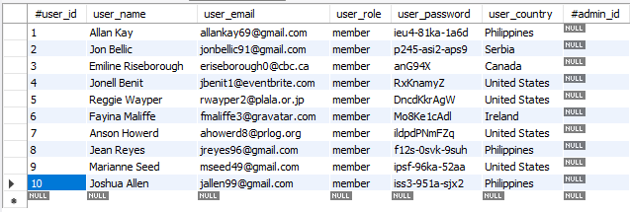
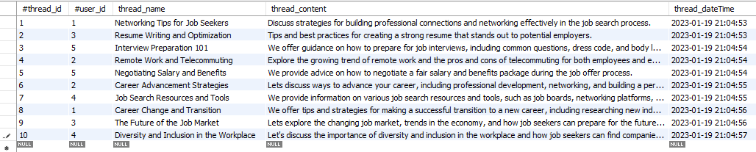
16. Project Results
User
Threads

Slide 46
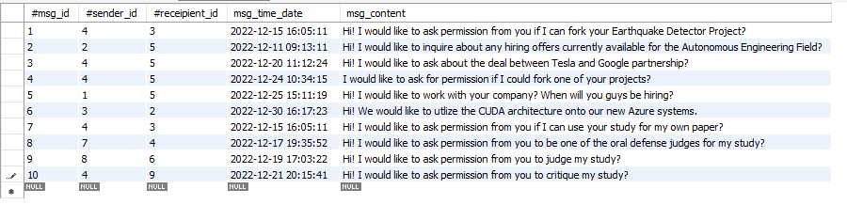
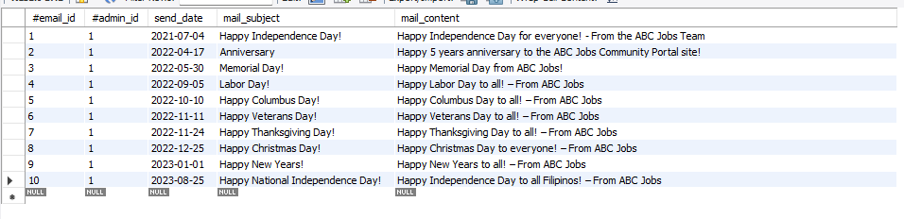
16. Project Results
Messages
Bulk Mail

Slide 47
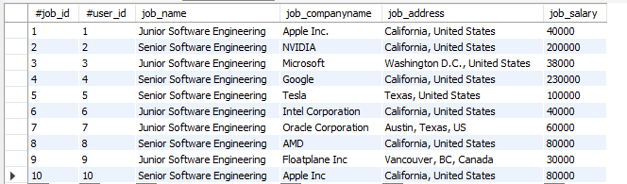
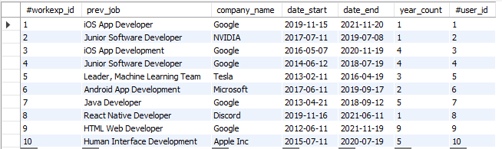
16. Project Results
Jobs
Experience

Slide 48

16. Project Results
Admin

Slide 49
17. Proposed Improvements
List of Improvements
  Run the MySQL Server on Linux.
  Adding more tables like User Details for a cleaner look.
  Using a NoSQL database like Apache Cassandra or MongoDB for Threads and Messages.

